Slide 1
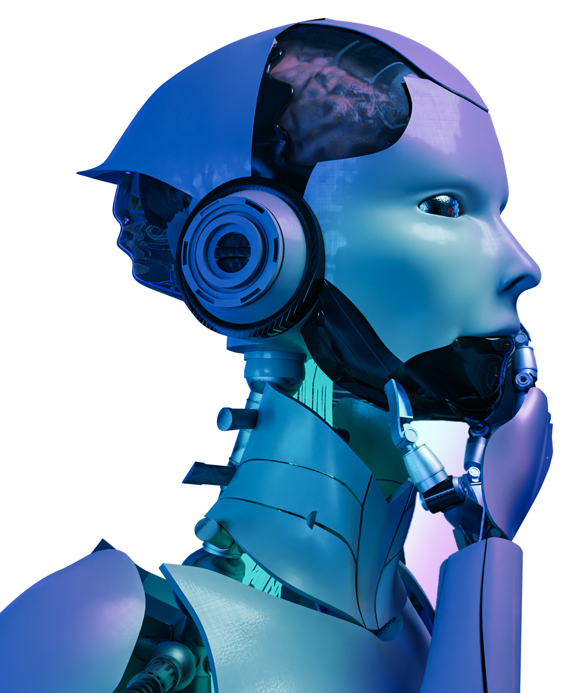
Synthetic
Dataset

Slide 2
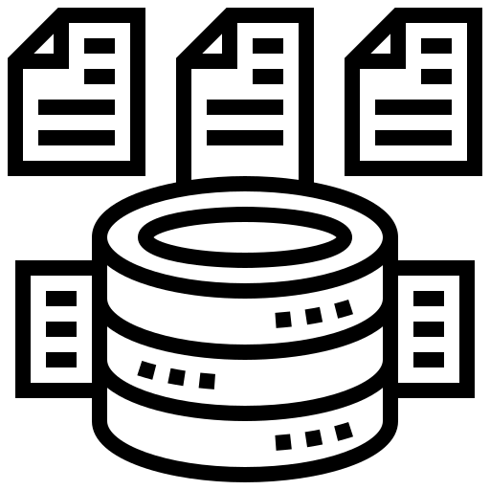


Machine Learning
Dataset
Model Training
Deployment
Notes:
More detail of the problem and the process of creating a model
Talk about the script being used in blender
Compare blender to other software
Why Roboflow and more visual
More visuals on orientated bounding box
Collect data on how synthetic dataset improve

Slide 3
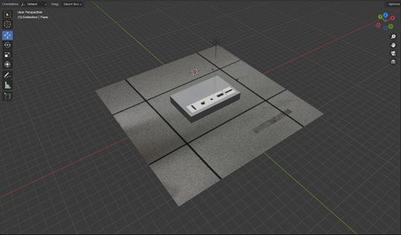

Synthetic Dataset
Problem:
Labeling dataset is time consuming
Limited amount of surface for the model to train on
Objective:
Increase efficiency of data collection by virtually generating annotated data automatically
Notes:
More detail of the problem and the process of creating a model
Talk about the script being used in blender
Compare blender to other software
Why Roboflow and more visual
More visuals on orientated bounding box
Collect data on how synthetic dataset improve

Slide 4
Abundant online resource
Robust community support
Support the entire 3D pipeline
Open source nature
Notes:
Support the entire 3D pipeline (annotation, modeling) 3D scene, Open source, robust community support, abundant online resources

Slide 5

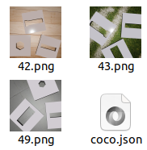
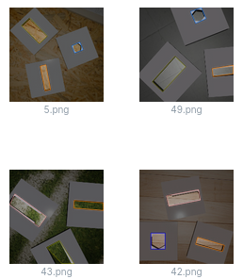
View and edit dataset
Support different annotation format
Augmentation feature
Notes:
Support the entire 3D pipeline (annotation, modeling) 3D scene, Open source, robust community support, abundant online resources

Slide 6
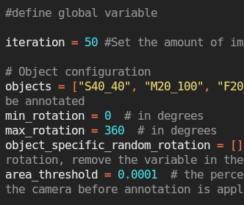
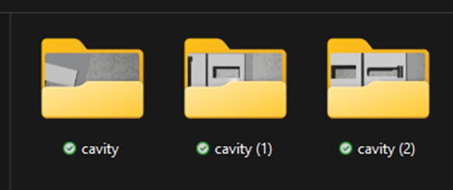
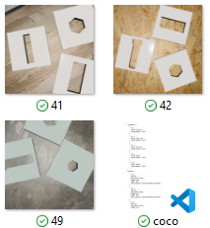
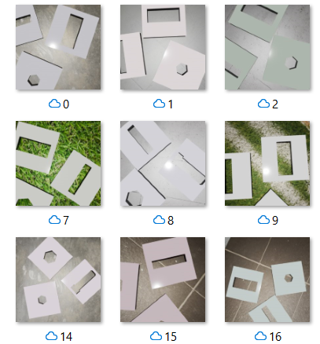
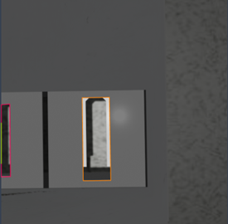
How it works
Notes:
Support the entire 3D pipeline (annotation, modeling) 3D scene, Open source, robust community support, abundant online resources

Slide 7
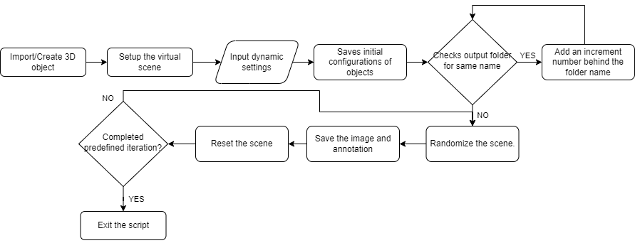
How it works
Notes:
Support the entire 3D pipeline (annotation, modeling) 3D scene, Open source, robust community support, abundant online resources

Slide 8
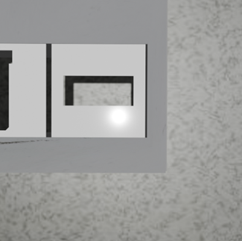
Scene Recreation
Import 3D object in 3D file such as STL
Enable use of CAD software
Online resources
Texture, material, and lighting can be applied to recreate lifelike scene virtually
Notes:
Support the entire 3D pipeline (annotation, modeling) 3D scene, Open source, robust community support, abundant online resources

Slide 9
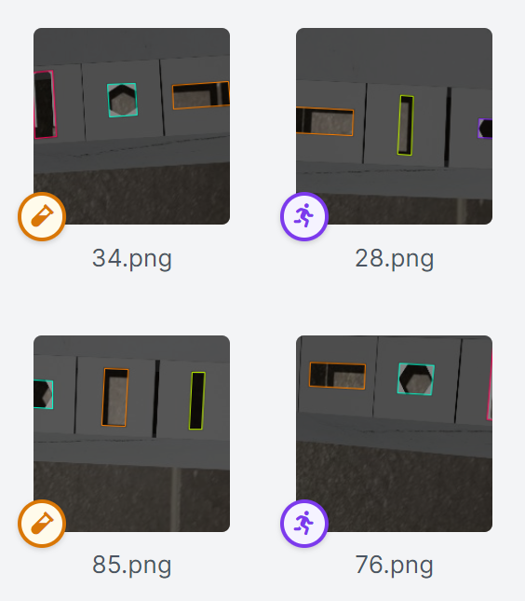
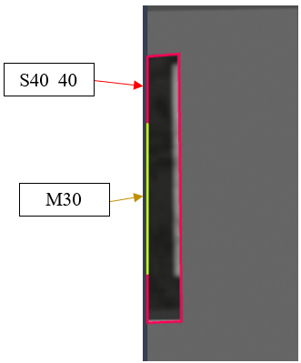
Bounding Box
Oriented Bounding Box
Area Threshold
Notes:
Support the entire 3D pipeline (annotation, modeling) 3D scene, Open source, robust community support, abundant online resources

Slide 10
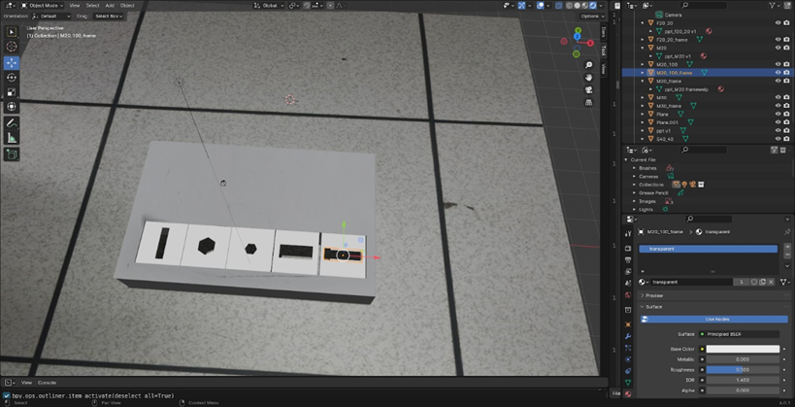
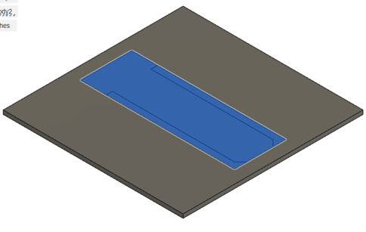
Object Frame
Blender:
Frame is the area to be annotated
Frame will move together with the object
CAD software:
Utilize CAD software to draw a frame
Frame will be relative to object position in Blender
Notes:
Support the entire 3D pipeline (annotation, modeling) 3D scene, Open source, robust community support, abundant online resources

Slide 11
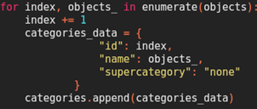
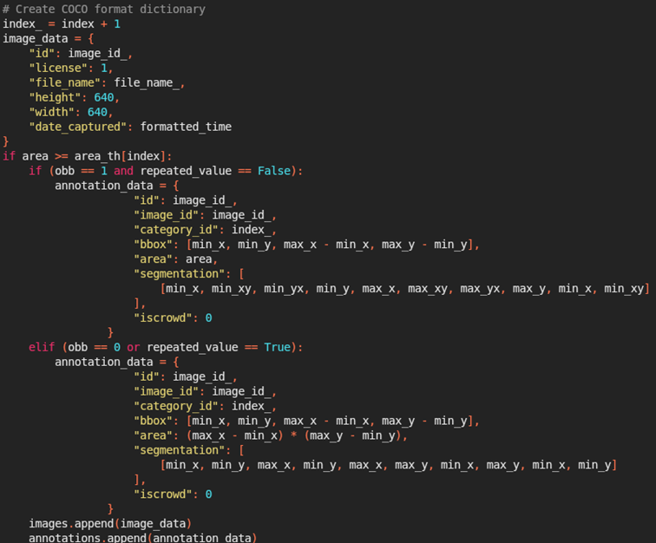
COCO Format
COCO Format:
Compatible for different annotation format
Supported in Roboflow
Components:
Categories
Images
annotations
Notes:
Support the entire 3D pipeline (annotation, modeling) 3D scene, Open source, robust community support, abundant online resources

Slide 12
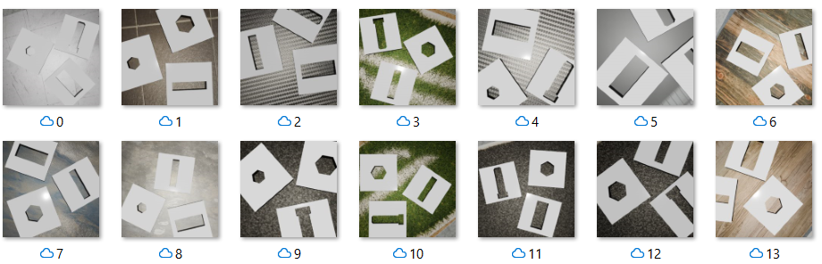
Output
Directory:
Save the directory as the project name
Add an incremental number to the name
File:
Image name accordingly to the sequence it is taken
Save annotation as JSON file
Notes:
Support the entire 3D pipeline (annotation, modeling) 3D scene, Open source, robust community support, abundant online resources

Slide 13
Dynamic Approach
Randomization of camera
Randomization of Material
Randomization of lighting
Randomization of object
Notes:
Support the entire 3D pipeline (annotation, modeling) 3D scene, Open source, robust community support, abundant online resources

Slide 14
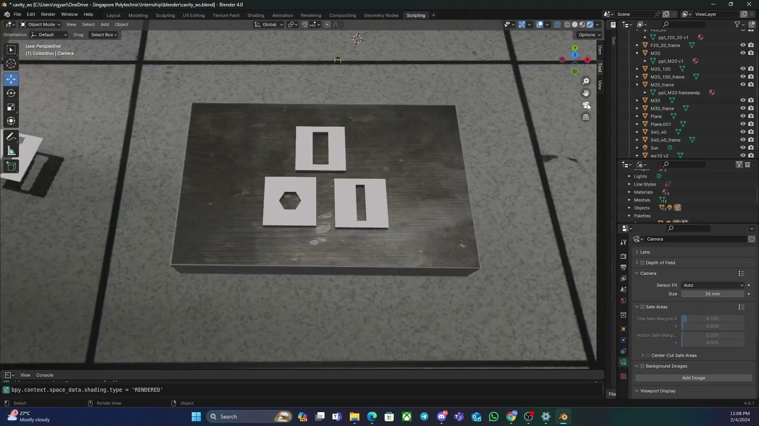
Demonstration
Notes:
Support the entire 3D pipeline (annotation, modeling) 3D scene, Open source, robust community support, abundant online resources

Slide 15
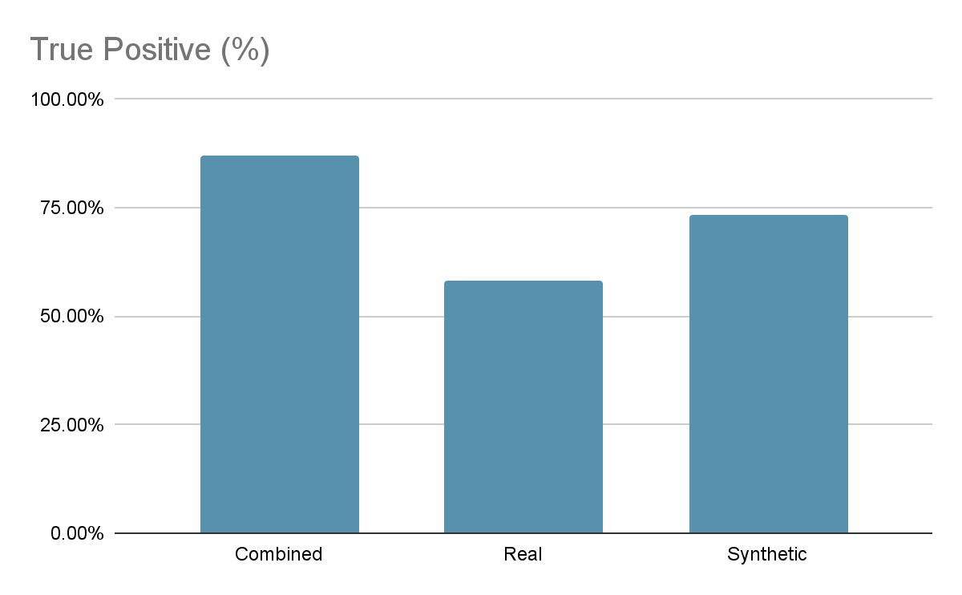
Conclusion
Setup:
500 real image
500 synthetic image
Outcome:
Combine dataset most accurate with 87.2%
29% more accurate than Real
13.8% more accurate than Synthetic
Notes:
Support the entire 3D pipeline (annotation, modeling) 3D scene, Open source, robust community support, abundant online resources

Slide 16
Conclusion
Advantages:
Easily diversify datasets
Efficiently generate large dataset
Disadvantage:
Cannot fully replicate real life dataset
Accuracy of dataset subjected to world setup
Application:
Mixture of real life dataset with synthetic dataset
Notes:
Support the entire 3D pipeline (annotation, modeling) 3D scene, Open source, robust community support, abundant online resources

Slide 17


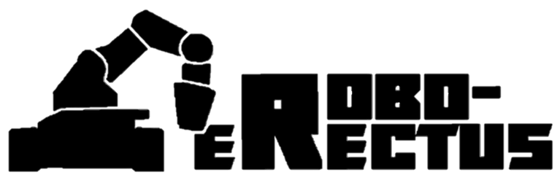
Thank You!
Special thanks to:
@roboerectus_atwork
Visit our Github

